Slide 1
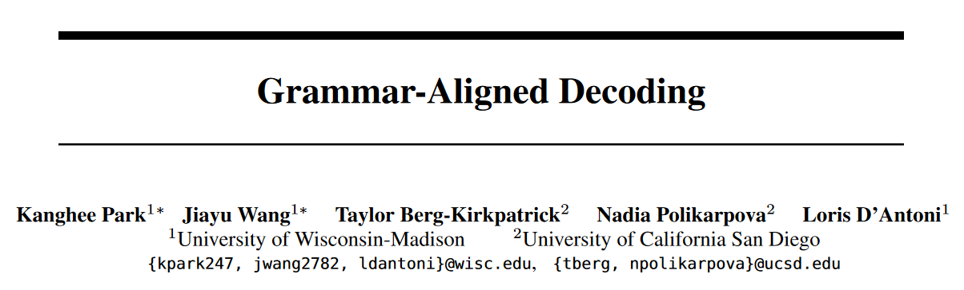
NeurIPS 2024

Slide 2
Abstract
Problem: LLMs cannot reliably generate highly structured outputs.
Constrained decoding: greedily restrict output token at each step.
Problem: This can distort the LLM's distribution.
The output is grammatical, but their likelihoods are not proportional to the ones given by the LLM.
Our solution: adaptive sampling with approximate expected futures.
Use prior sample outputs to soundly overapproximate the future grammaticality of different output prefixes.
Evaluation on code generation and structured NLP tasks shows that this can often produce outputs with higher likelihood while still enforcing the desired constraints.

Slide 3
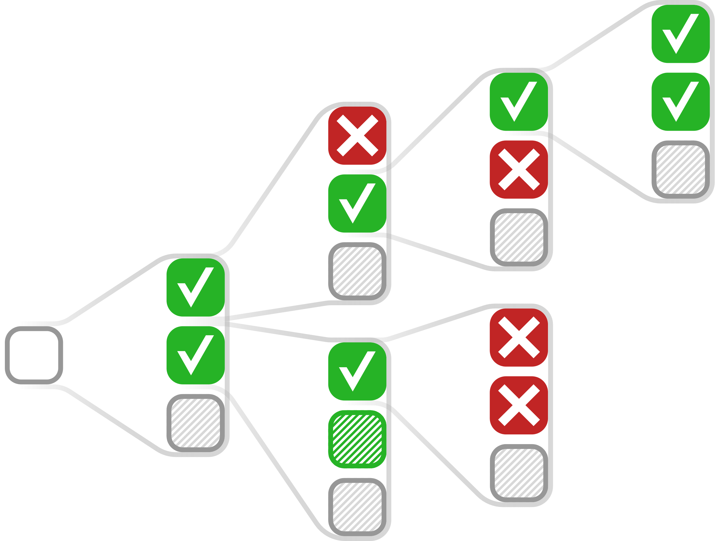
(Grammar-)Constrained Decoding
Problem LLMs often struggle with generating highly structured outputs.
Constrained decoding Greedily "forcing" the LLM output to satisfy the given constraint.

Slide 4
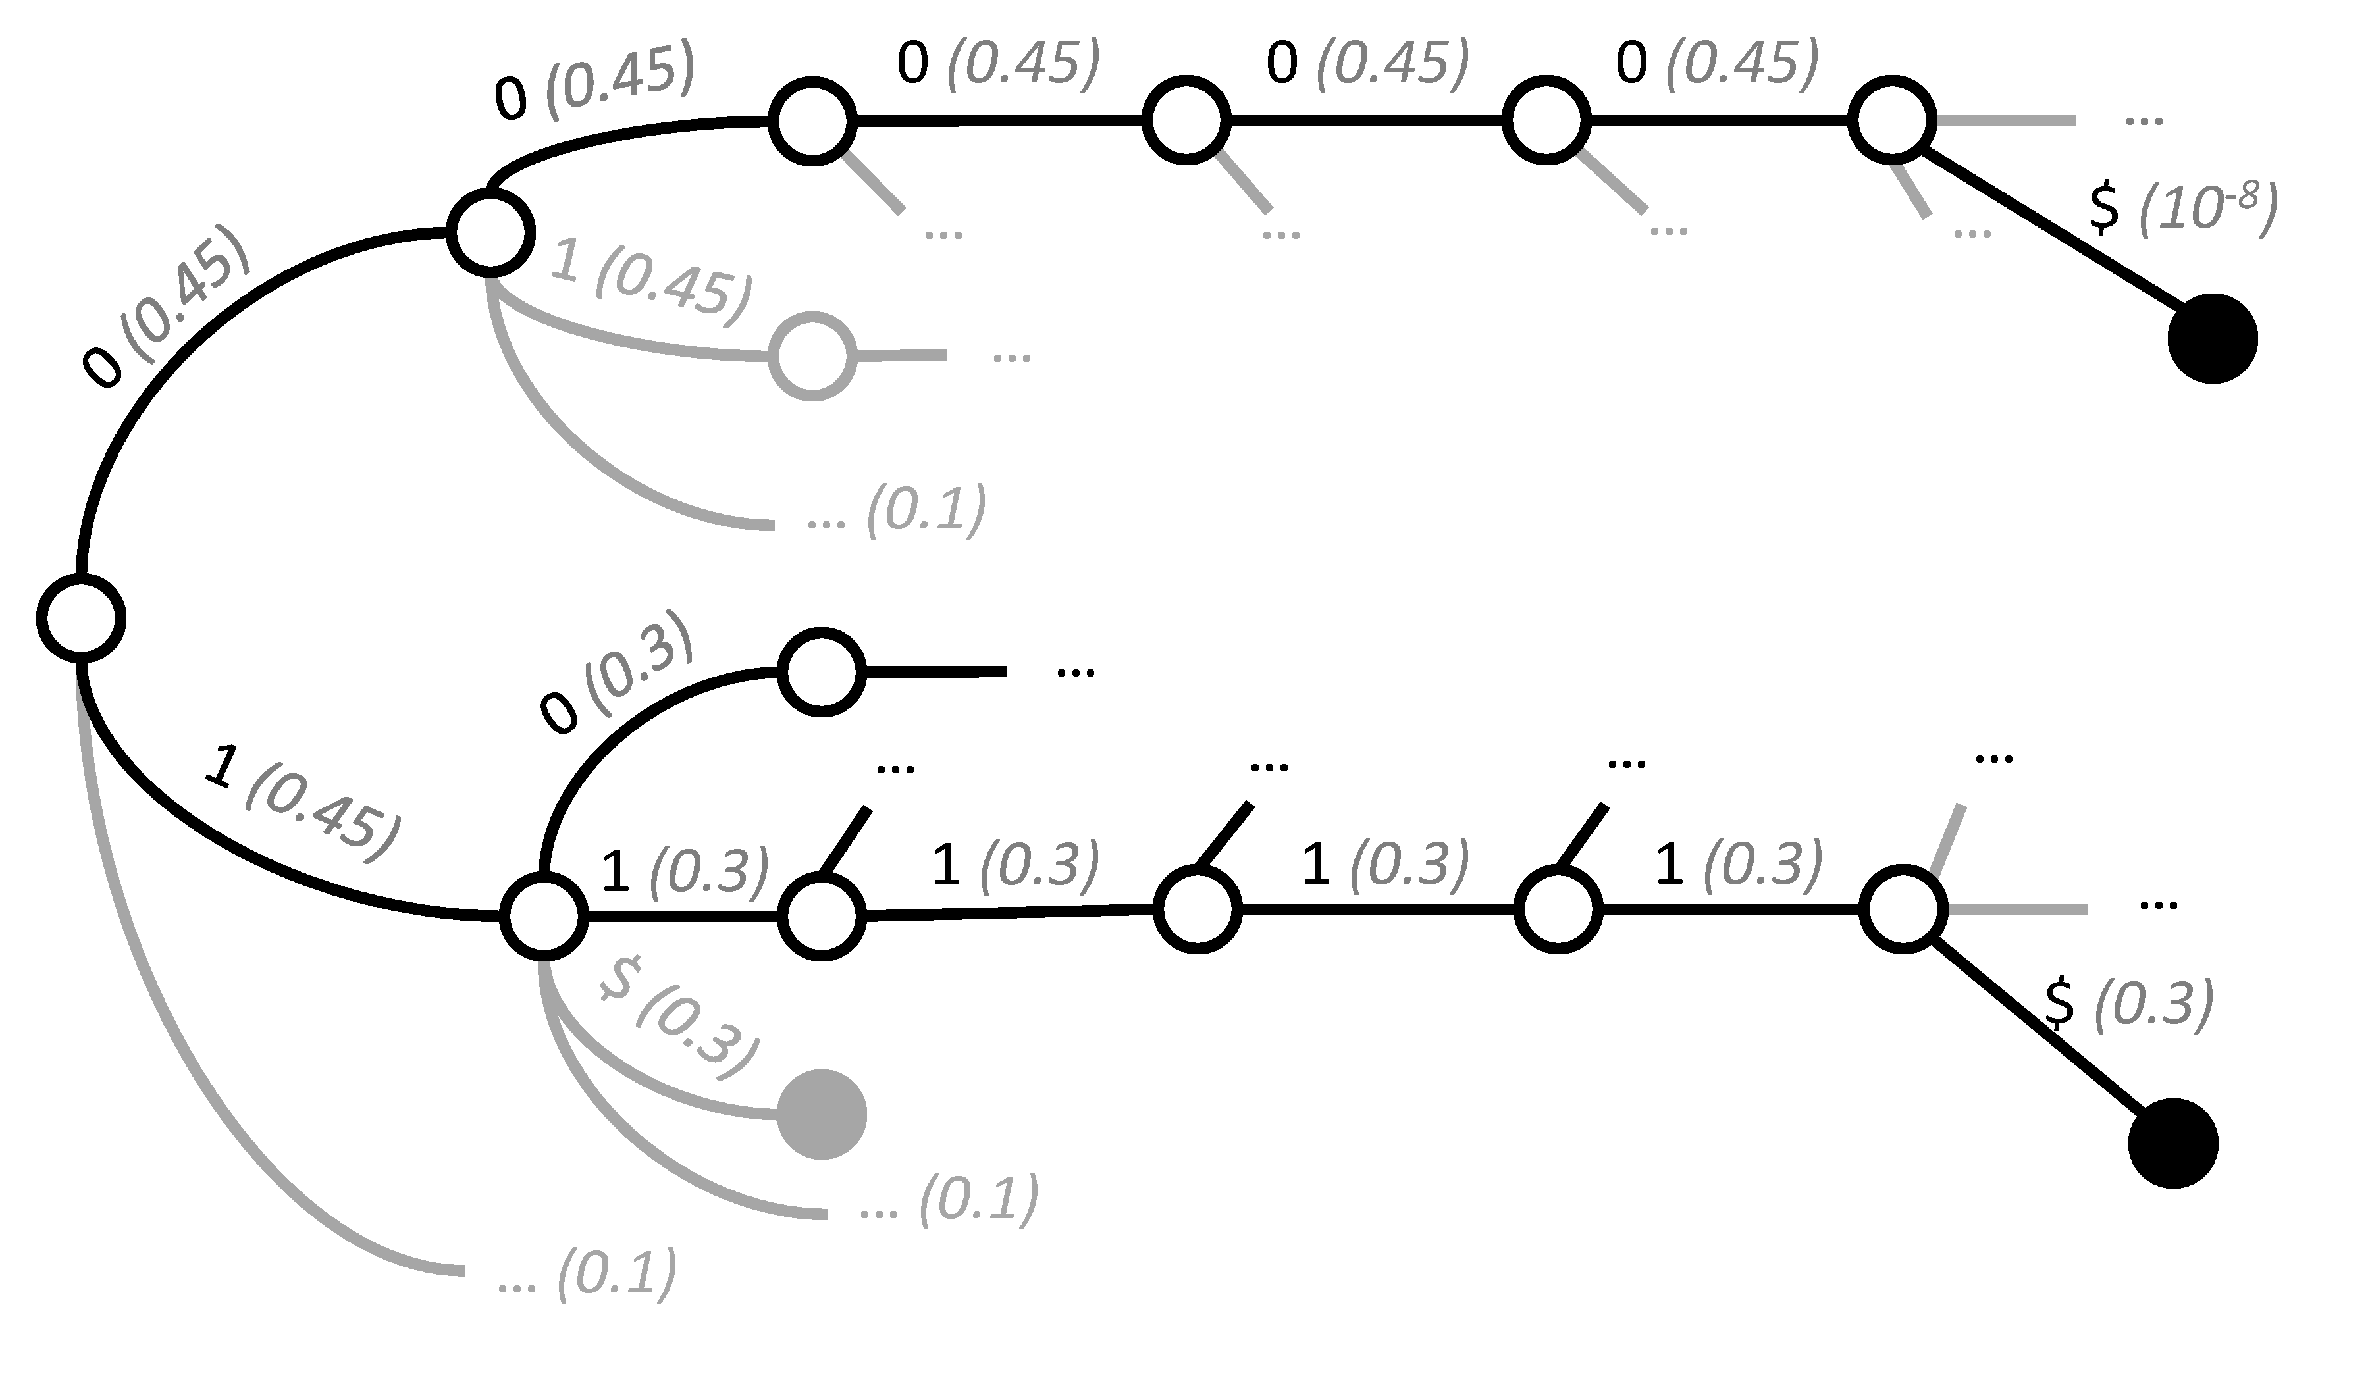
Problem of GCD
Problem GCD distorts the LLM's learned language distribution.
Example
Grammar: 00000|1[01]{4}
Prompt: generate a binary string that ends with a 1
Expected: high prob to 1xxx1; low prob to 00000; zero prob to any other string.
GCD: Only 30% output ends with 1.

Slide 5
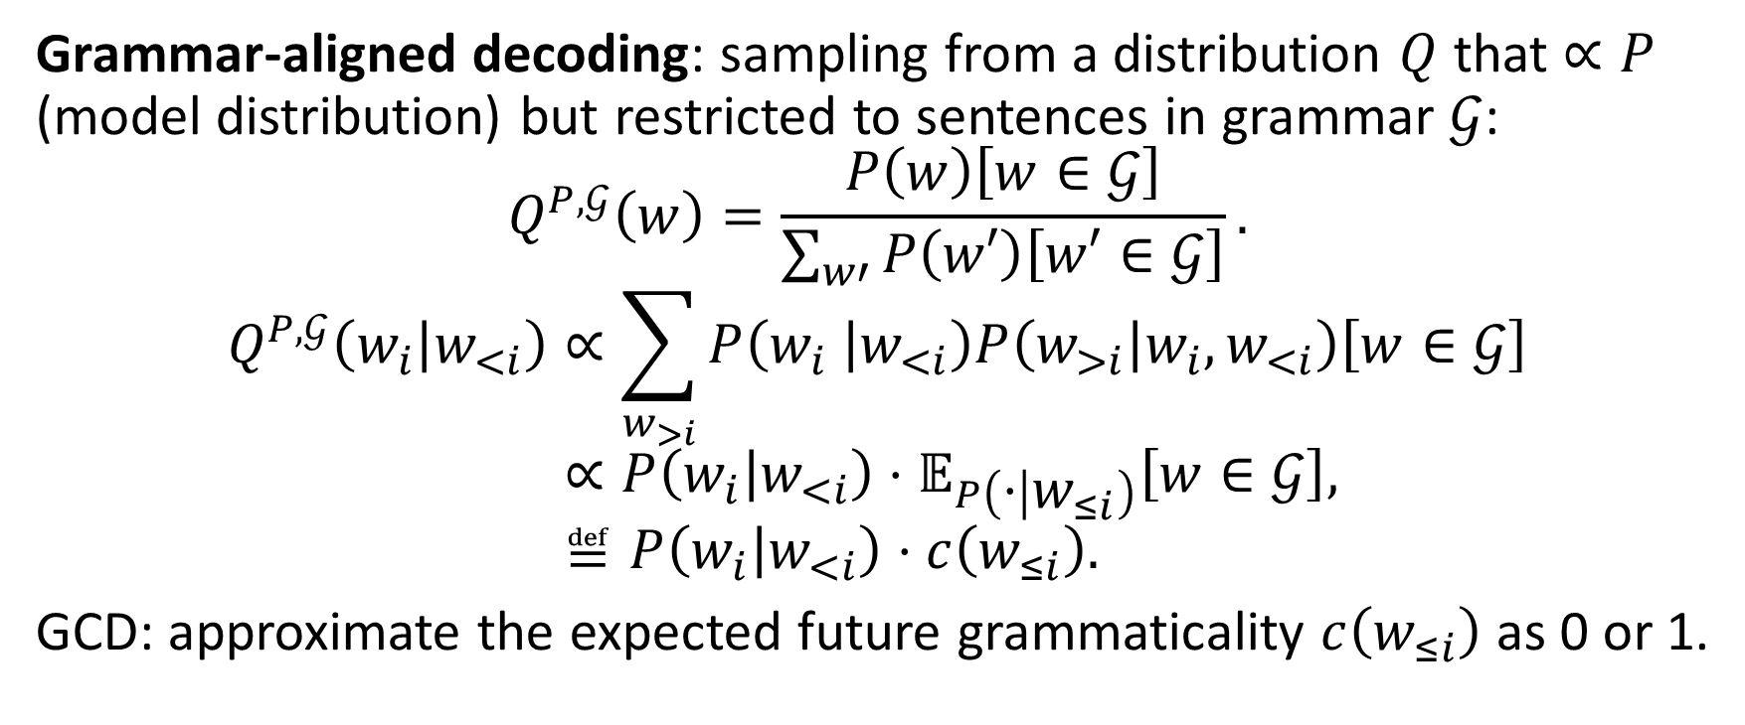
Grammar-Aligned Decoding
Grammar-aligned decoding: sampling from a distribution $Q$ that $∝P$ (model distribution) but restricted to sentences in grammar $𝒢$:
$$Q^{P,𝒢}\left(w\right)=\frac{P\left(w\right)\left[w∈𝒢\right]}{\sum_{w′}{P\left(w′\right)\left[w′∈𝒢\right]}}.$$
$$Q^{P,𝒢}\left(w_{i} | w_{<i}\right)∝\sum_{w_{>i}}{P\left(w_{i} | w_{<i}\right)P\left(w_{>i} | w_{i},w_{<i}\right)\left[w∈𝒢\right]} \\ ∝P\left(w_{i} | w_{<i}\right)⋅𝔼_{P\left(⋅ | w_{≤i}\right)}\left[w∈𝒢\right], \\ ≝P\left(w_{i} | w_{<i}\right)⋅c\left(w_{≤i}\right).$$
GCD: approximate the expected future grammaticality $c\left(w_{≤i}\right)$ as 0 or 1.

Slide 6
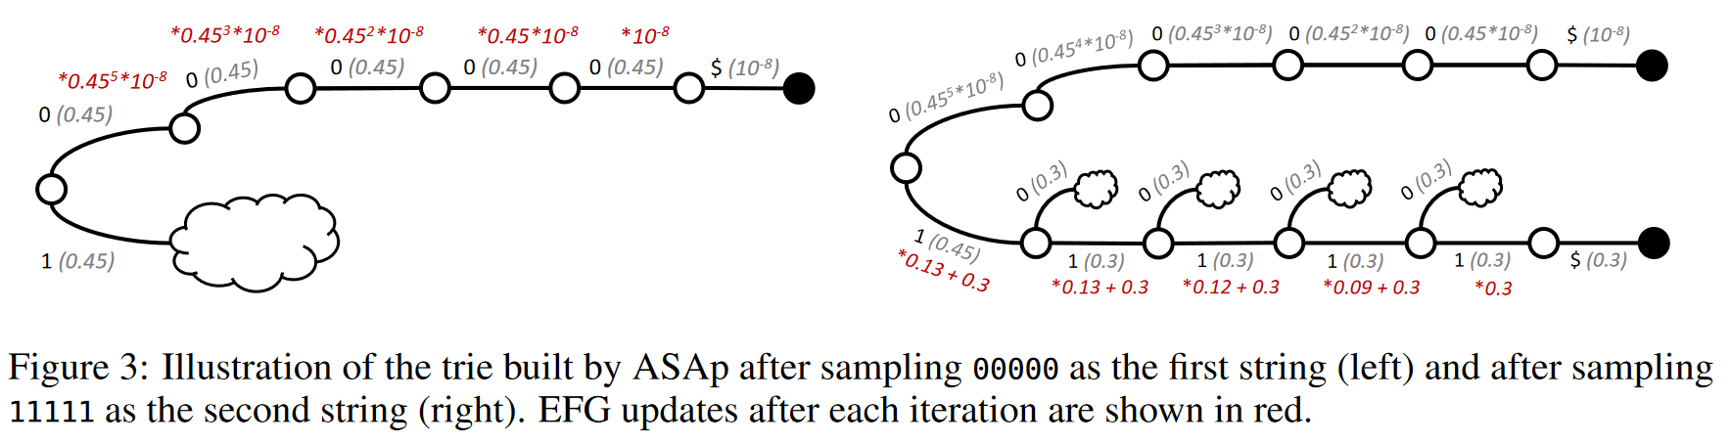
Adaptive Sampling with Approximate Expected Futures
Problem: Exact GAD is intractable.
Solution: Sample repeatly, and use previous sampling results to direct future sampling.

Slide 7
Experimental Setup
Datasets: the previous example and 3 structured-decoding tasks.
SLIA (15): strings with inear integer arithmetic;
INV-BV (15): loop invariant generation with bit-vector arithmetic;
CP (6): constituency parsing.
Prompt: 3 in-context examples of (specification, solution).
Model: Mistral-7B.
Measures: 2000 iterations / sample.

Slide 8
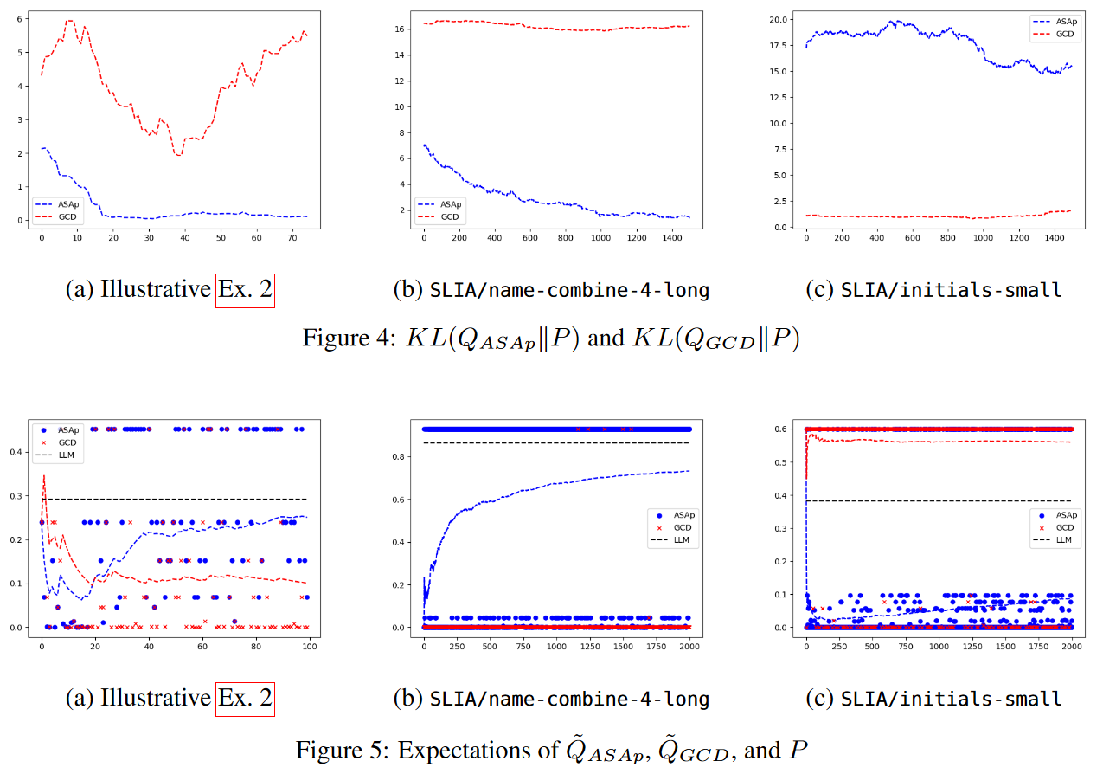
Experiments

Slide 9
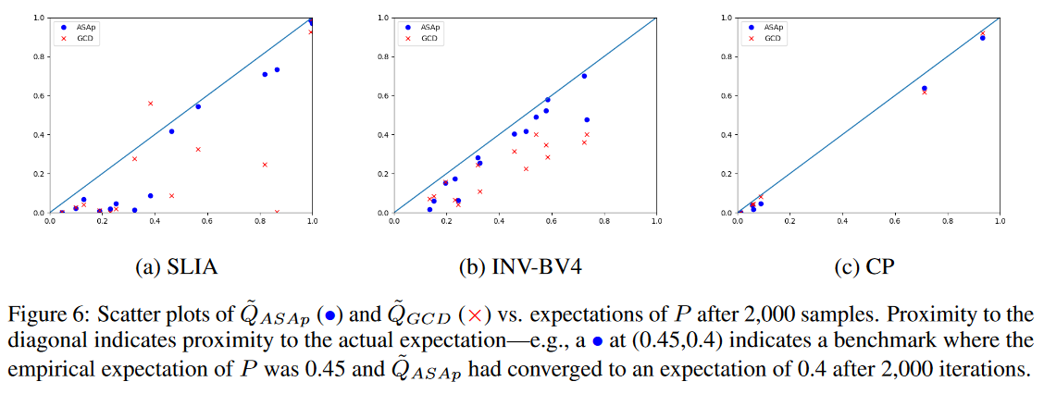
Experiments

Slide 10
Discussion and Limitations
No strong effect on solving downstream tasks.
But sometimes it can sample the correct solutions more often than GCD.
Slow convergence of the ASAp algorithm.

Slide 11
End.

Slide 12
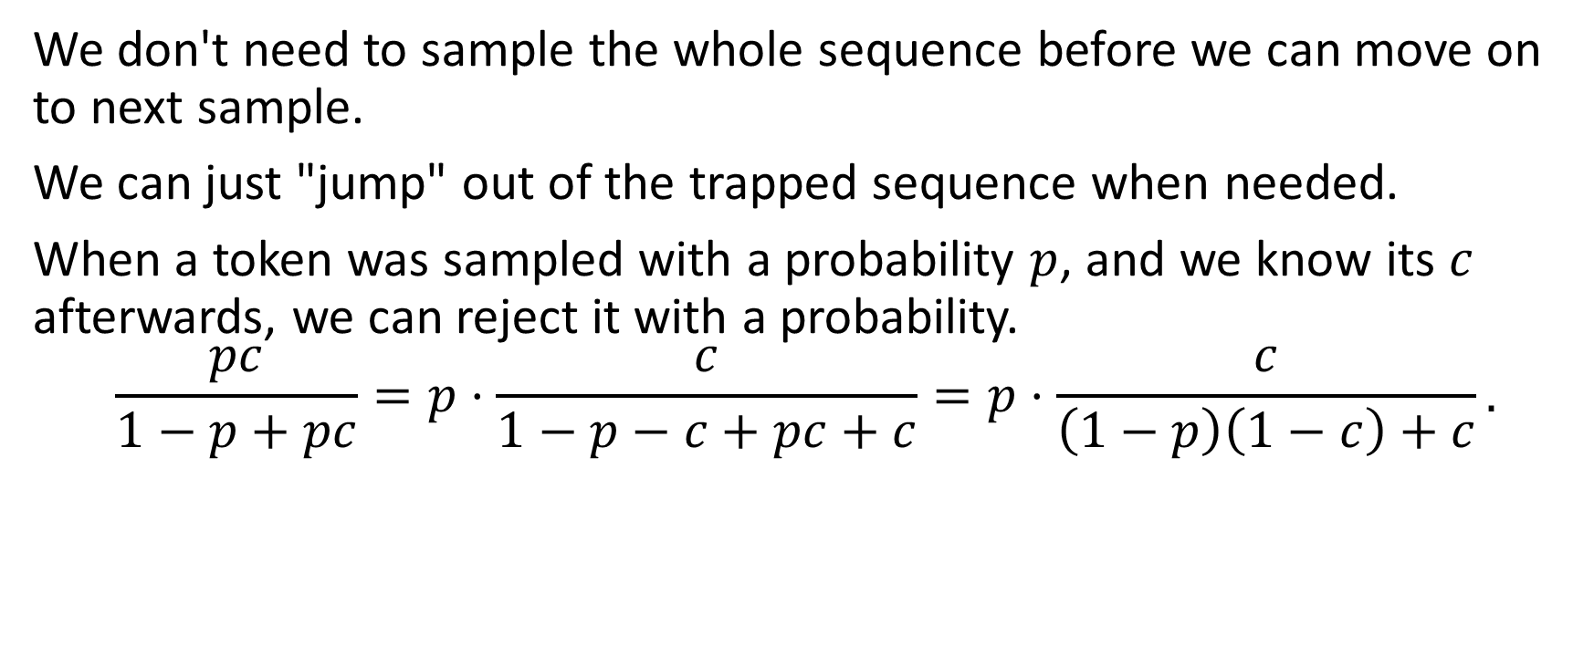
My idea
We don't need to sample the whole sequence before we can move on to next sample.
We can just "jump" out of the trapped sequence when needed.
When a token was sampled with a probability $p$, and we know its $c$ afterwards, we can reject it with a probability.
$$\frac{pc}{1−p+pc}=p⋅\frac{c}{1−p−c+pc+c}=p⋅\frac{c}{\left(1−p\right)\left(1−c\right)+c}.$$

